Slide 1
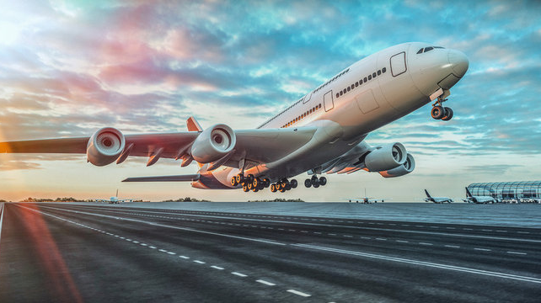
AIRLINES DATA ANALYSIS

Slide 2
AGENDA
Understanding the business problem
Exploring the dataset to identify patterns
Analyzing key variables
Maximizing company revenue streams through the utilization of occupancy rates

Slide 3
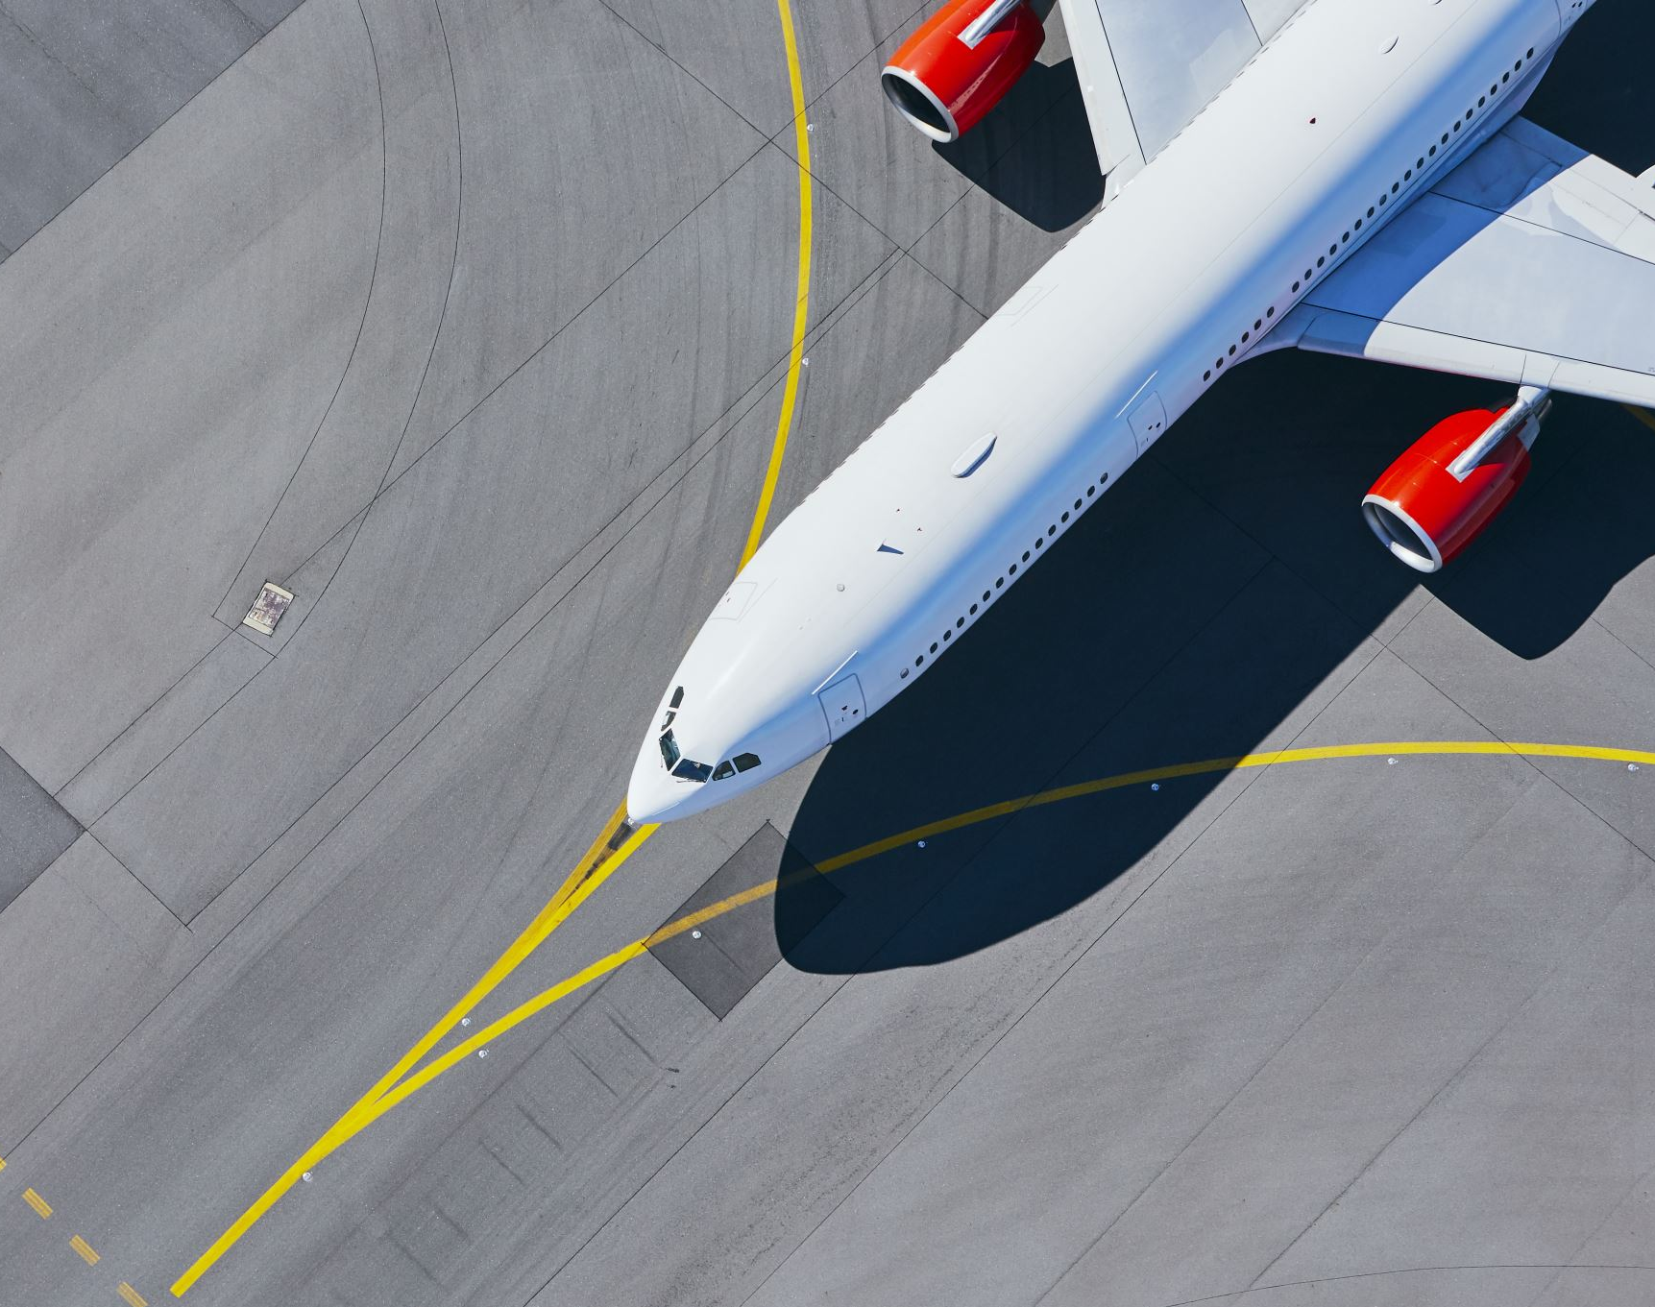
EXECUTIVE SUMMARY
In this summary, we'll delve into the challenges faced by an airline business in revenue generation.
By analyzing revenue and bookings over time, along with leveraging occupancy rates, we explore strategies to mitigate these challenges to some extent.

Slide 4
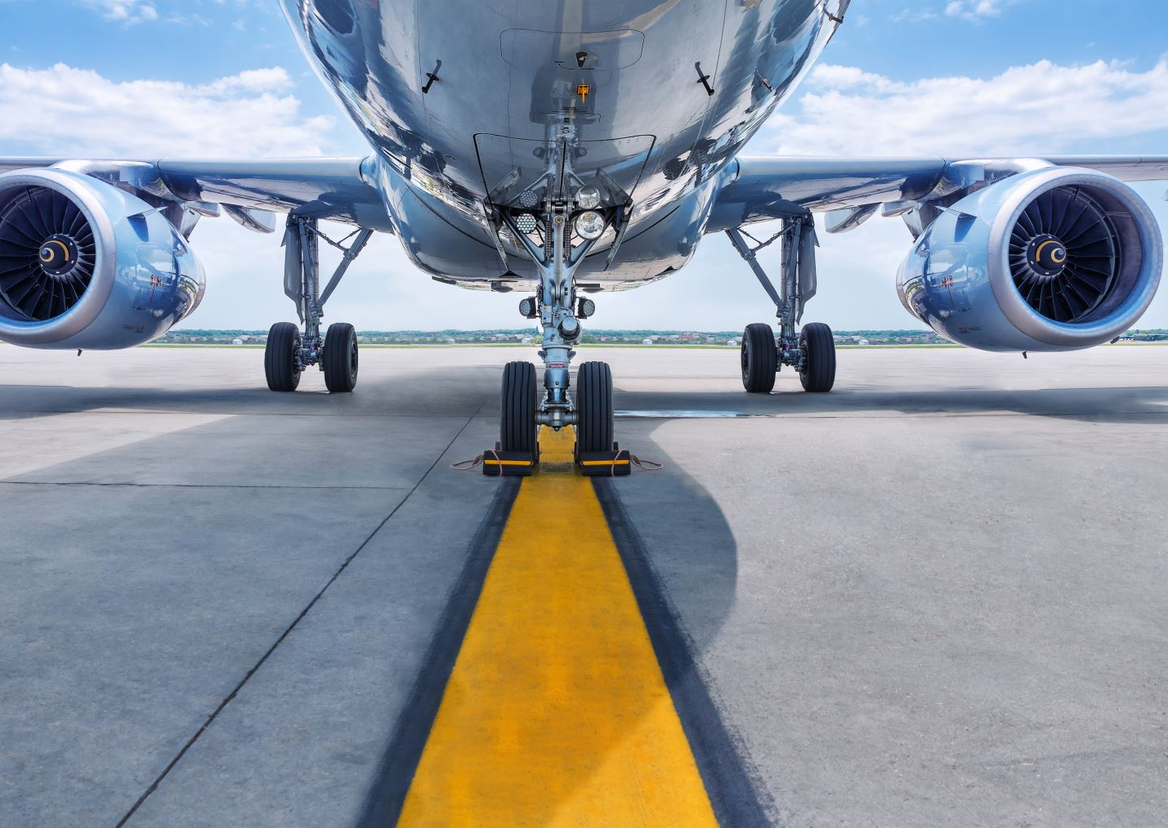
BUSINESS PROBLEM
The company has been providing transportation services for many years to its customers and operates a diverse fleet of aircraft, including small business jets and medium-sized machines.
However, it is currently facing challenges stemming from higher flight taxes, environmental regulations, and other factors. Consequently, the company's profitability is under pressure.

Slide 5
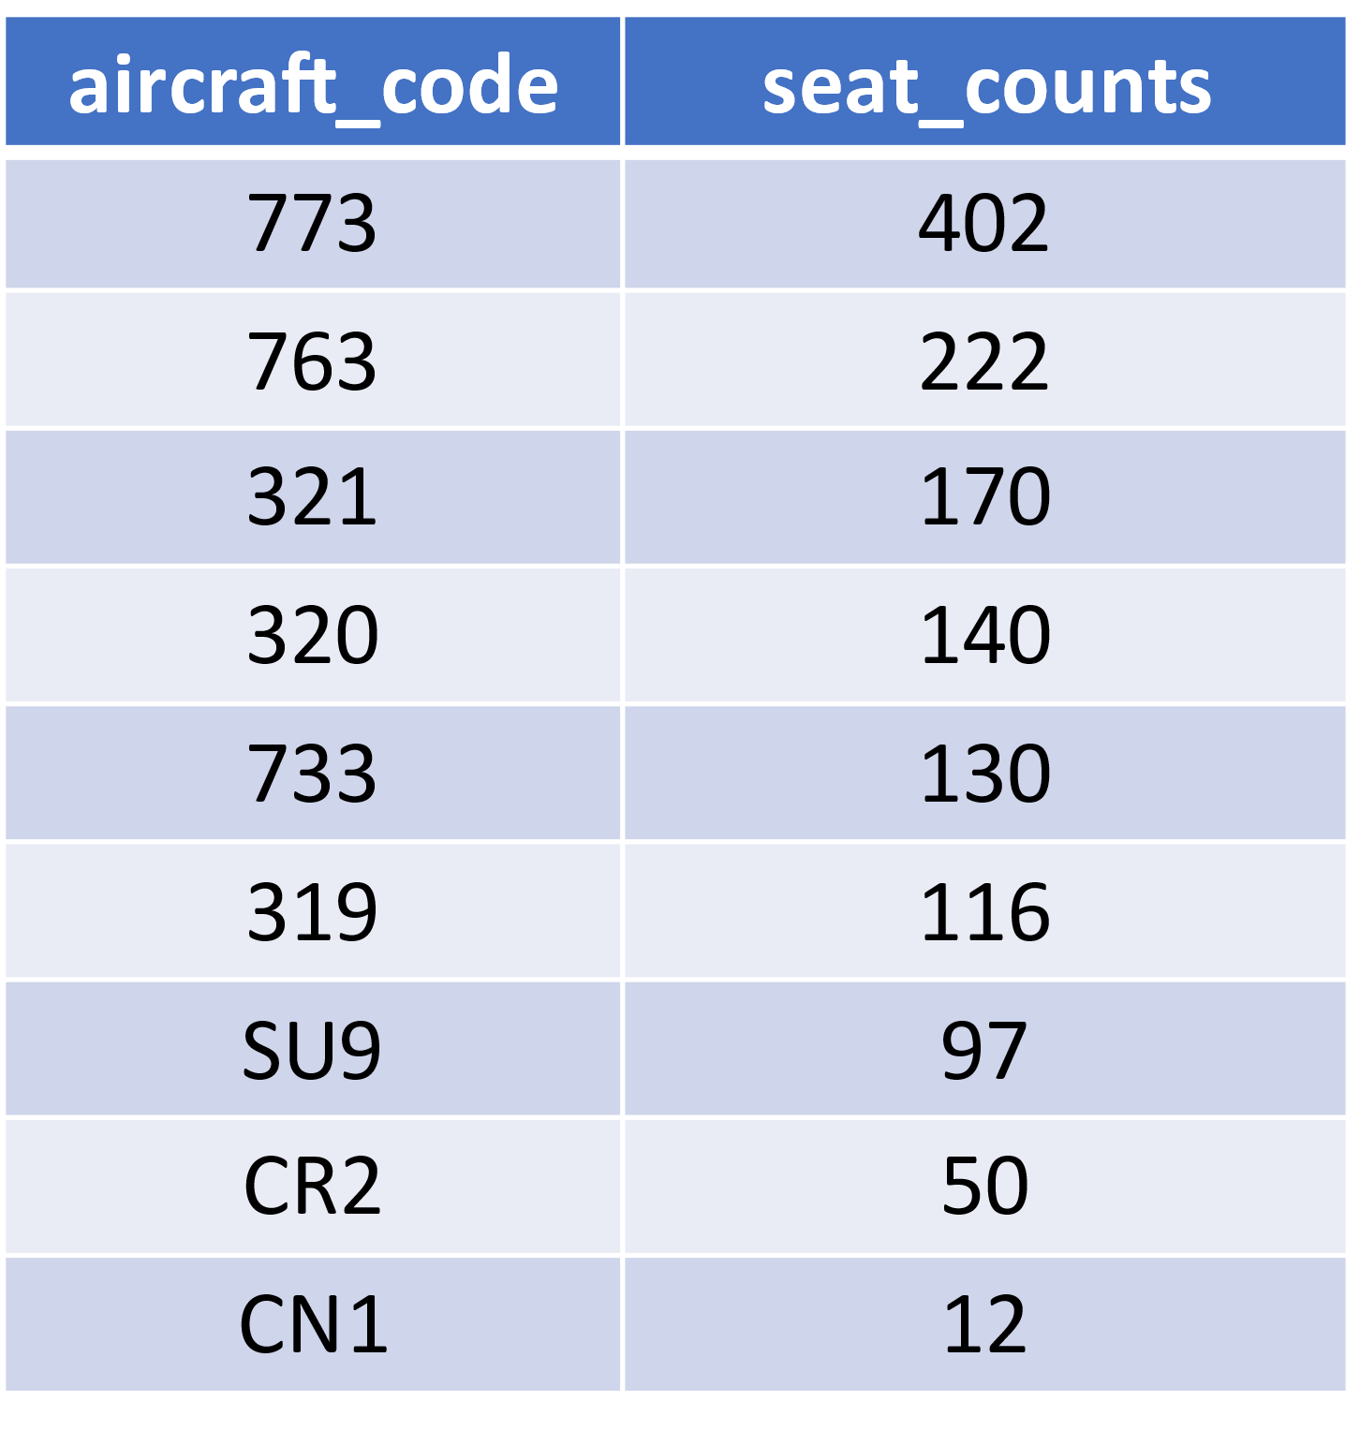
AIRCRAFT SEATING TOTALS
Aircraft 773 boasts the highest seating capacity, with 763 following closely at 222 seats.
The CNA aircraft offers the lowest seating option.

Slide 6
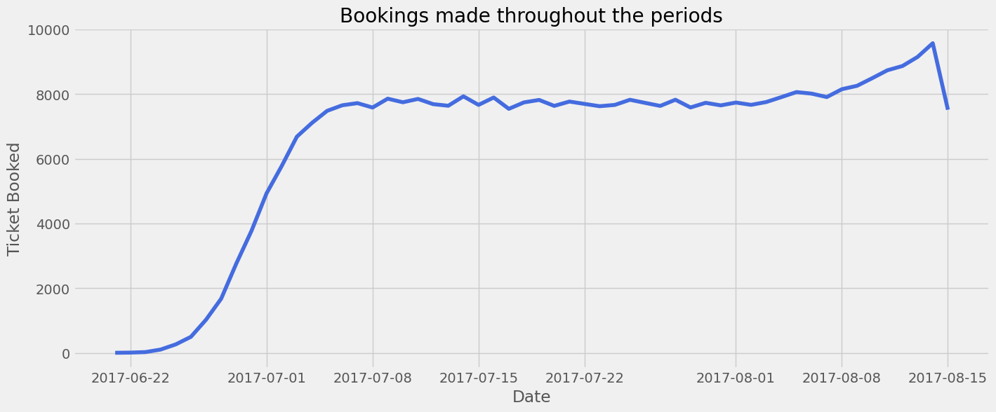
PERIOD BOOKING TRENDS
In the first week of July, the airline experienced increased bookings, which remained stable throughout the month
A gradual increment was observed from the beginning until August 14th, followed by a slight drop

Slide 7
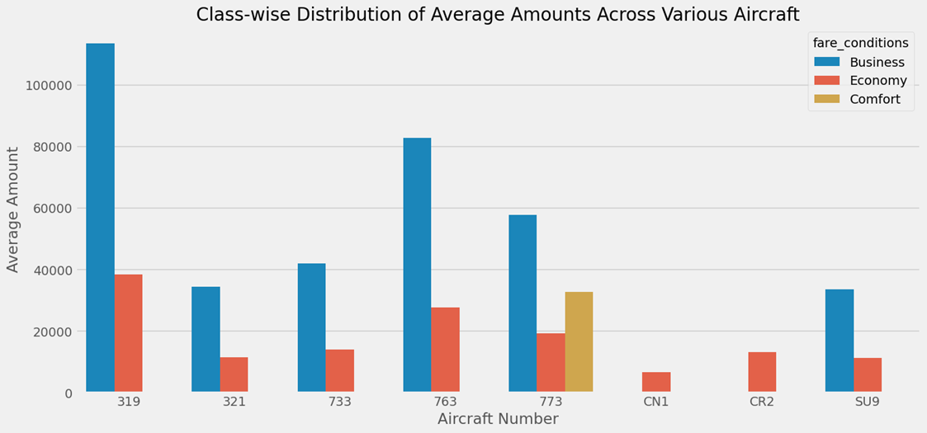
AIRCRAFT CLASS-WISE AVERAGE AMOUNTS
Aircraft number 773 is the only one offering all three classes (Business, Economy, Comfort).
aircraft number 319 having the highest prices for both business and economy classes.
The second-highest prices for business and economy classes are found in aircraft number 763.

Slide 8
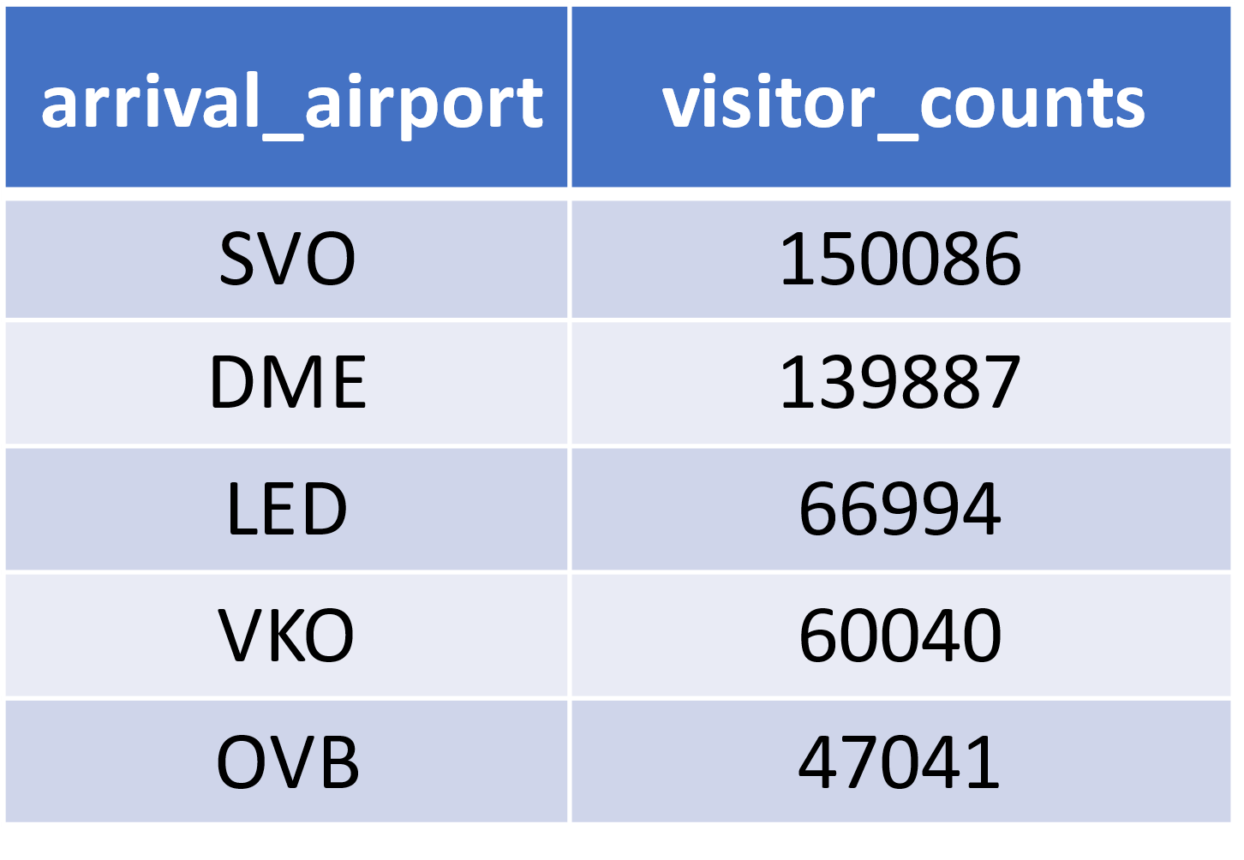
PREFERRED TRAVEL HUB
SVO and DME airports serve as major travel hubs, drawing in a substantial number of passengers due to their popularity or strategic locations.
In contrast, LED, VKO, and OVB airports witness a consistent flow of approximately 55,000 travelers over an extended period.

Slide 9
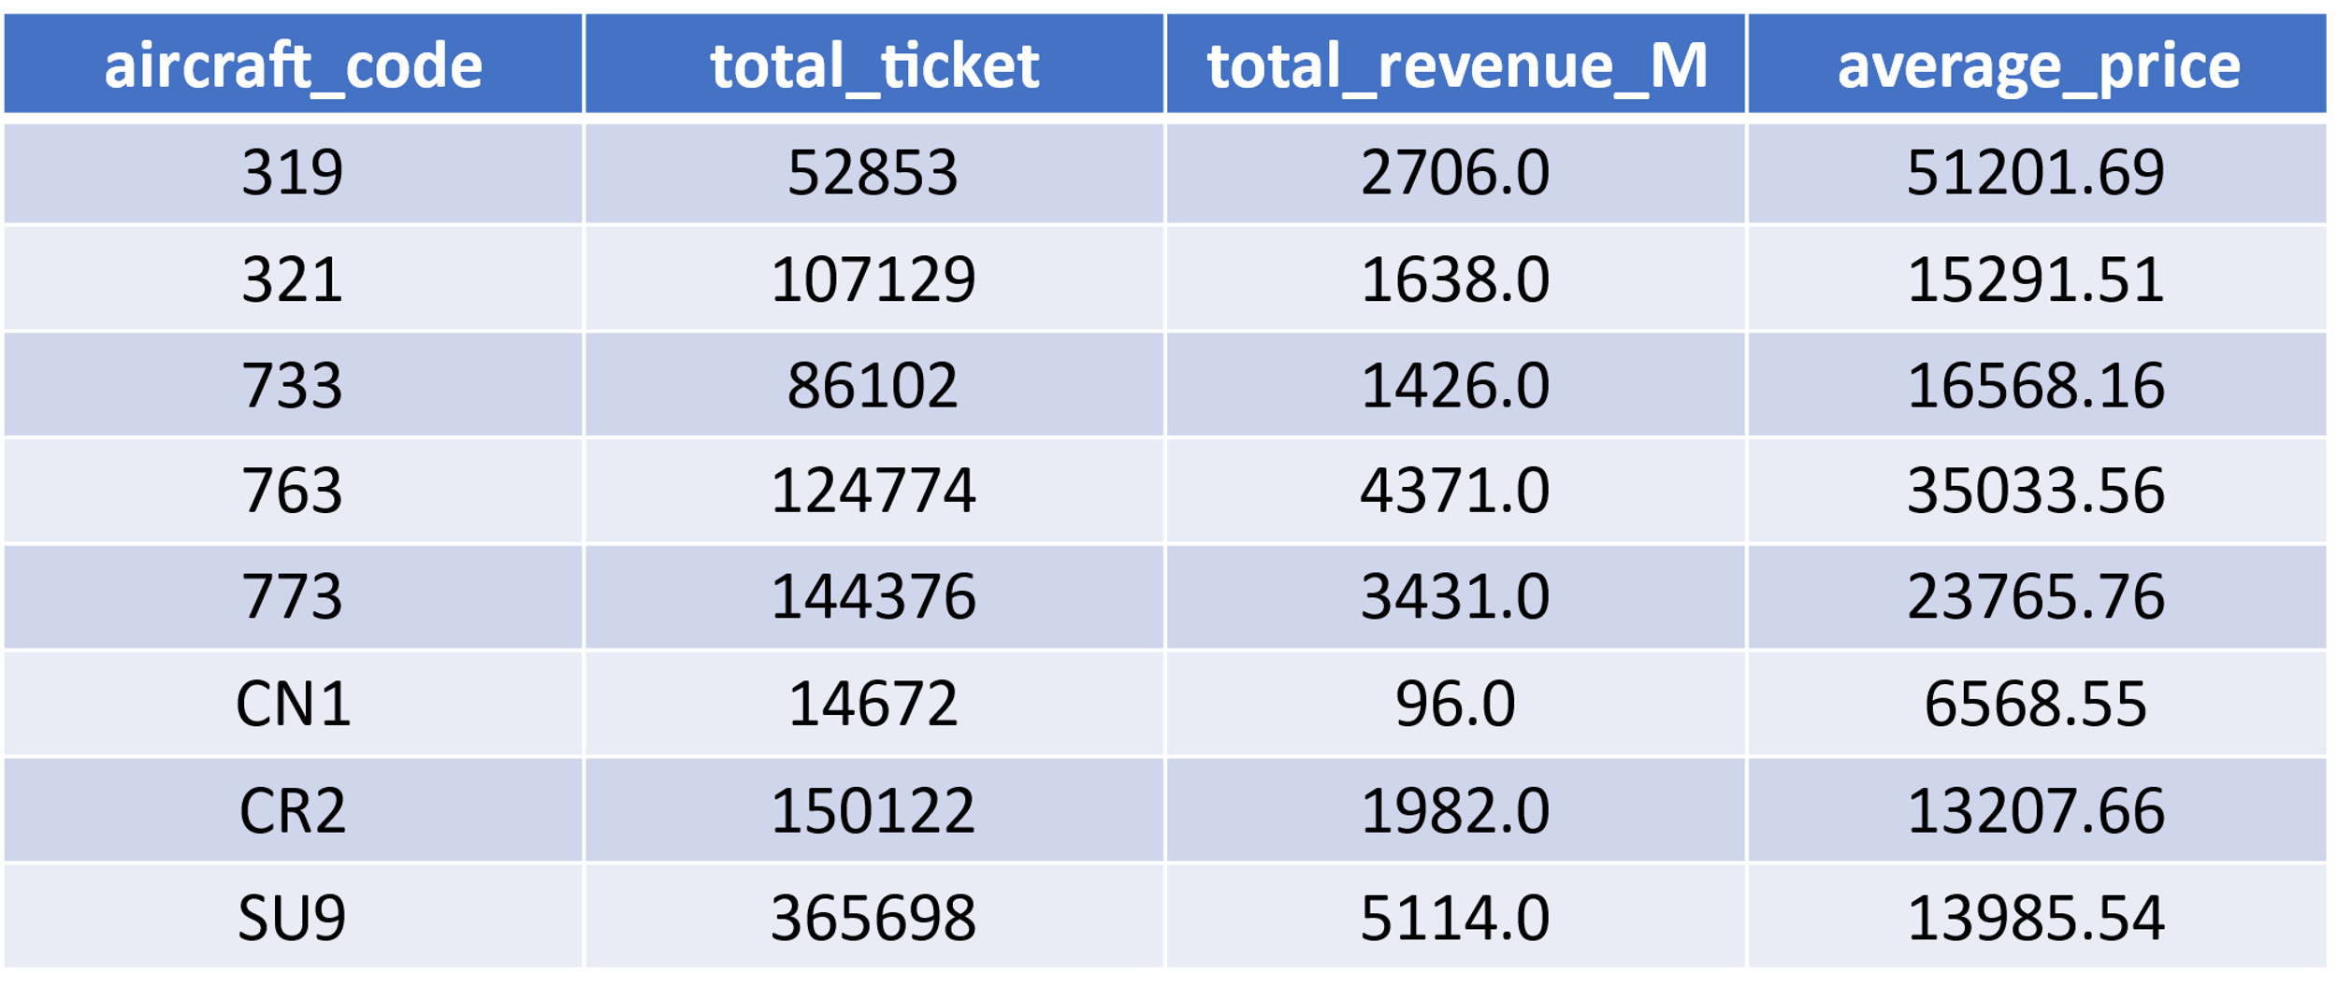
PRICING AND TICKET SUMMARY
Aircraft number 733 leads in revenue, offering all three classes (Business, Economy, Comfort).
Aircraft 319 appears to have a higher cost per ticket at 51201.69, suggesting it may operate long-haul routes or offer premium amenities.
The lowest revenue is attributed to aircraft CN1, possibly due to its exclusive provision of Economy class or limited facilities.

Slide 10
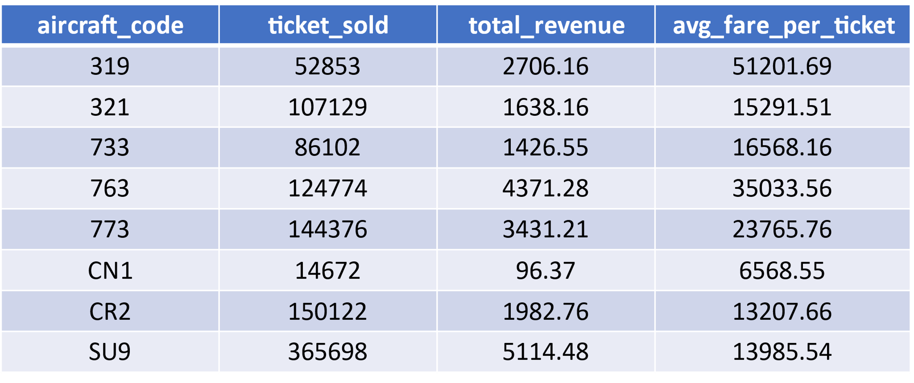
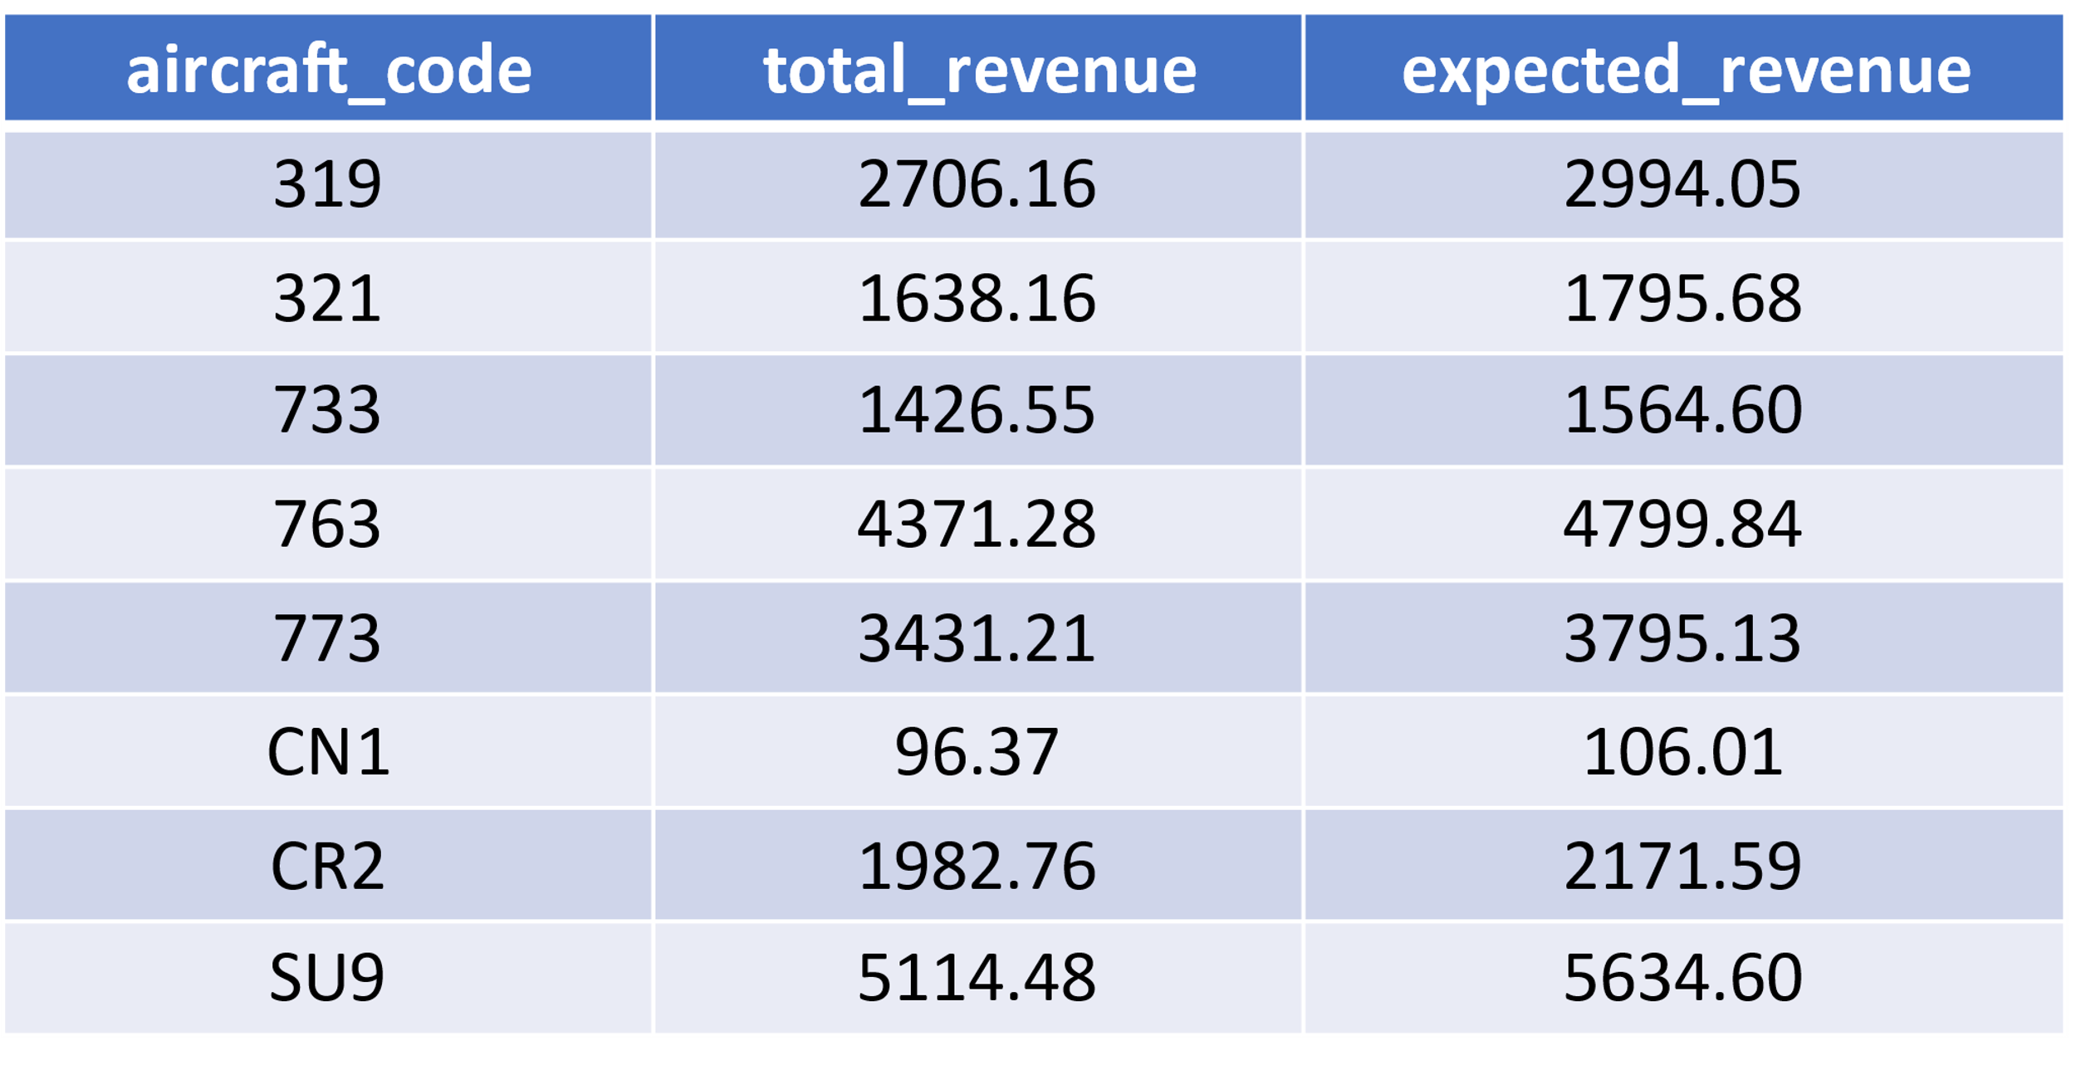
SEAT OCCUPANCY PATTERN
The majority of aircraft do not reach full capacity, with approximately 50% of seats booked on each aircraft.
The annual turnover of the airlines could see improvement by increasing the occupancy rate in all aircraft by 10%

Slide 11
CONCLUSION
Concentrate promotional activities in the mid-month period when bookings are more stable.
Consider targeted advertising for aircraft with lower sales, such as 733, SU9, or 319.
To maximize the increased demand during the initial weeks of July and August, particularly for aircraft numbers 321, 763, and 773 at DME and SVO locations, focus should be placed on boosting the occupancy rate.

